Slide 1



Data Wrangling and Analysis
Navigating Through Data Challenges to Gain Insights
Presentation
Deewankar Sharma

Slide 2
Preparing data for analysis and gaining insights.
Dataset 1, Dataset 2, and Dataset 3.
Importance of data wrangling and analysis in ensuring data quality and making informed decisions.
Introduction
New future

Slide 3

This project showcases a comprehensive data analysis project conducted in Python using Pandas, NumPy, and Seaborn libraries. The project follows a structured approach starting from data acquisition, data exploration, data cleaning, to data wrangling. Data Acquisition: The project begins by loading multiple datasets using Pandas read_excel function. Each dataset is then printed to inspect its structure and content. Data Exploration: Basic exploratory data analysis (EDA) techniques are employed to understand the datasets better. This includes printing the first few and last few entries, getting data type information, generating descriptive statistics, and identifying missing values using info(), head(), tail(), describe(), and isnull().sum(). Data Cleaning: Missing values are addressed through various techniques such as filling them with mean, median, or mode values using fillna() function. Outliers are detected using box plots and the interquartile range (IQR) method, and then removed from the dataset. Data Wrangling: The datasets are combined using the merge() function and concatenated using concat() function. Necessary columns are dropped, and the combined dataset is prepared for further analysis. Summary Statistics and Visualization: Summary statistics such as mean, median, mode, skewness, and correlation coefficients are calculated to gain insights into the data distribution and relationships between variables. Seaborn box plots are used to visualize outliers in numerical features. Data Export: The cleaned and processed dataset is exported to a CSV file for further analysis or modeling.
Project Overview

Slide 4


Data Set Used
Data Set 1
This dataset contains detailed information about bike rentals, including date, season, weather conditions, temperature, humidity, wind speed, and rental counts. It serves as the primary source of data for our analysis.
Data Set 2
Similar to Dataset_1, Dataset_2 provides additional information about bike rentals, which will be merged with Dataset_1 to enrich our dataset.
Data Set 3
Dataset_3 complements the information provided in Dataset_1 and Dataset_2, contributing further insights into bike rental patterns.

Slide 5
Date: Represents the date of the bike ride, which is essential for analyzing temporal trends in rental patterns.
Season: Categorizes the season into spring, summer, fall, and winter, aiding in understanding seasonal variations in bike rentals.
Weather Conditions: Describes the weather conditions on the day of the rental, influencing user preferences and rental demands.
Temperature and Humidity: Reflect the weather's impact on bike rental behavior, as users may be more or less inclined to ride based on these factors.
Wind Speed: Indicates the strength of the wind, which can affect the comfort and safety of biking.
Rental Counts: Provides the total number of bike rentals, including both registered and non-registered users, serving as the primary metric for analysis and prediction.
Key Attributes and Significance

Slide 6

Data Acquisition
Data acquisition is the process of sourcing data that can be cleaned and pre-processed and later used to train machine learning algorithms.
The first step involves acquiring datasets from various sources.
Python libraries such as Pandas and NumPy are used to load and manipulate the data.
Datasets include information related to bike sharing, weather conditions, and other relevant factors.

Slide 7
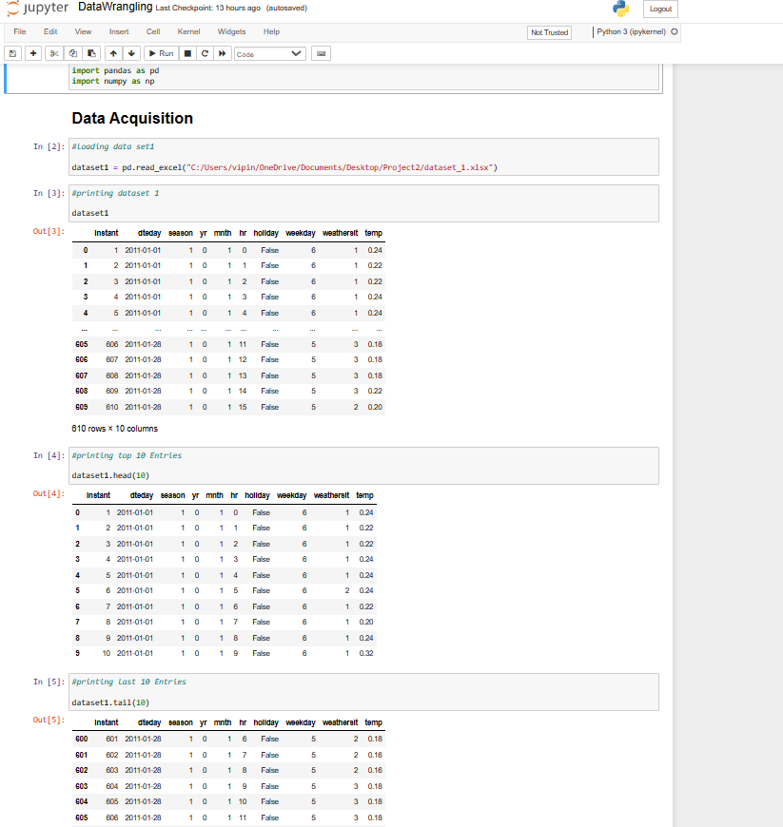

Slide 8
Data Exploration
Data exploration is often the first step allowing you to perform an initial evaluation of your data’s structure and underlying patterns. Utilizing this tool can better inform your data analysis and more accurately represent your data. I
Displayed key statistics (mean, median, min, max, etc.) of Dataset 1 using descriptive statistics functions to provide an overview of the data distribution.
Provided a preview of Dataset 2 to familiarize the audience with its structure and content, facilitating a deeper understanding.

Slide 9
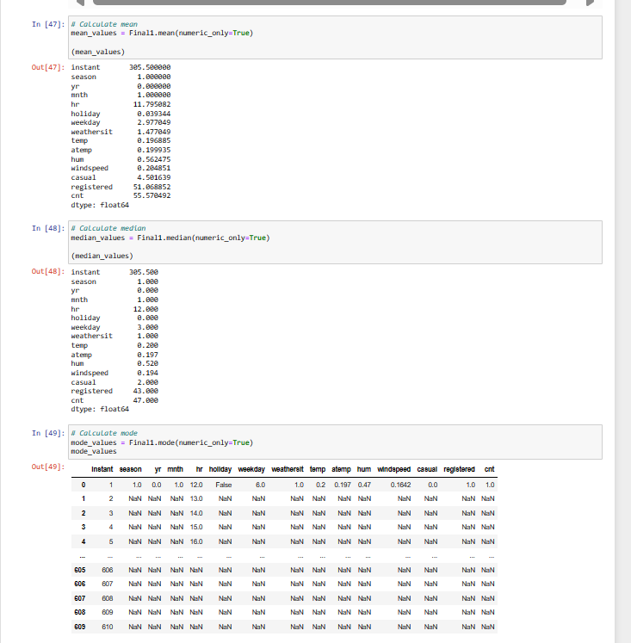

Slide 10
Data cleaning is the process of preparing data for analysis by removing or modifying data that is incorrect, incomplete, irrelevant, duplicated, or improperly formatted.
Data Cleaning
Data cleaning is crucial for ensuring data quality and accuracy in analysis.
Techniques such as handling missing values, detecting and removing outliers, and transforming data are applied.
The goal is to prepare the data for analysis by addressing any inconsistencies or errors.

Slide 11
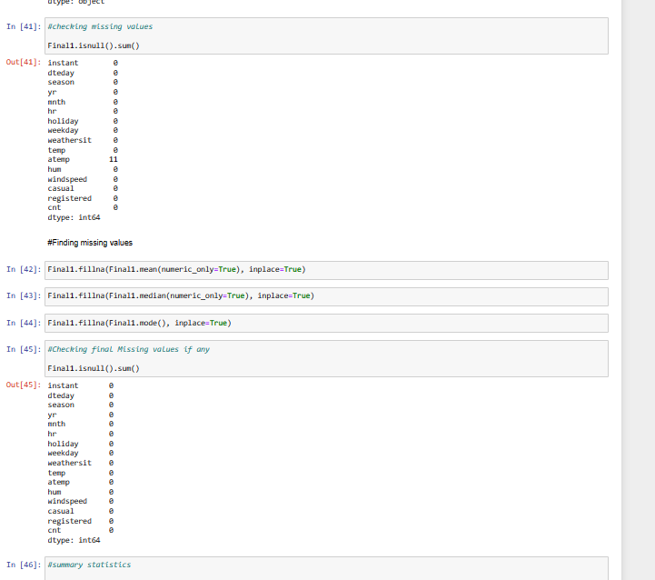

Slide 12
Data Cleaning- Outlier Detection
Outliers are data points that deviate significantly from the average or expected pattern, and they can have a significant impact on statistical models and machine learning algorithms. Outliers can arise due to various reasons such as measurement errors, data entry mistakes, or even genuine extreme values in the data.
Boxplots have been used to display selected features to visually identify outliers
Interquartile Range (IQR) method is used for detecting outliers and removing them from the dataset to ensure robust analysis.

Slide 13
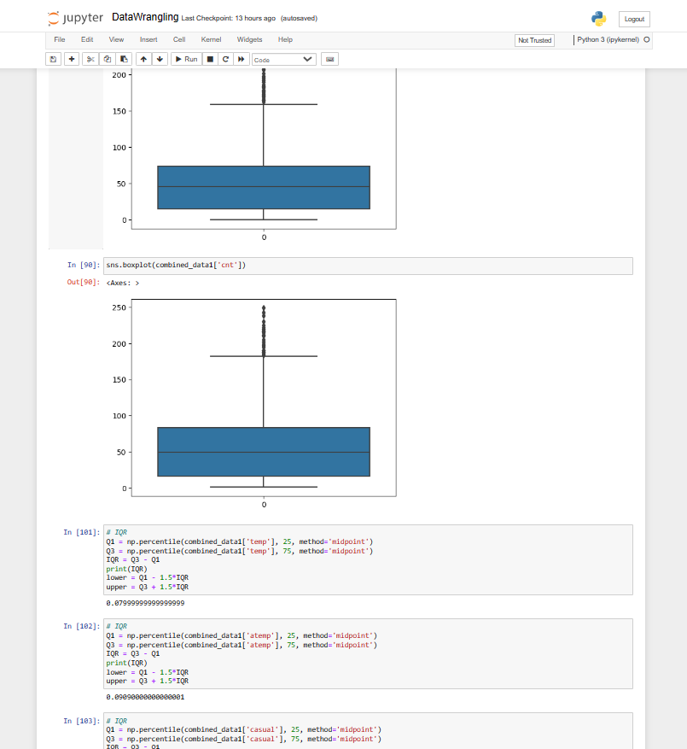

Slide 14
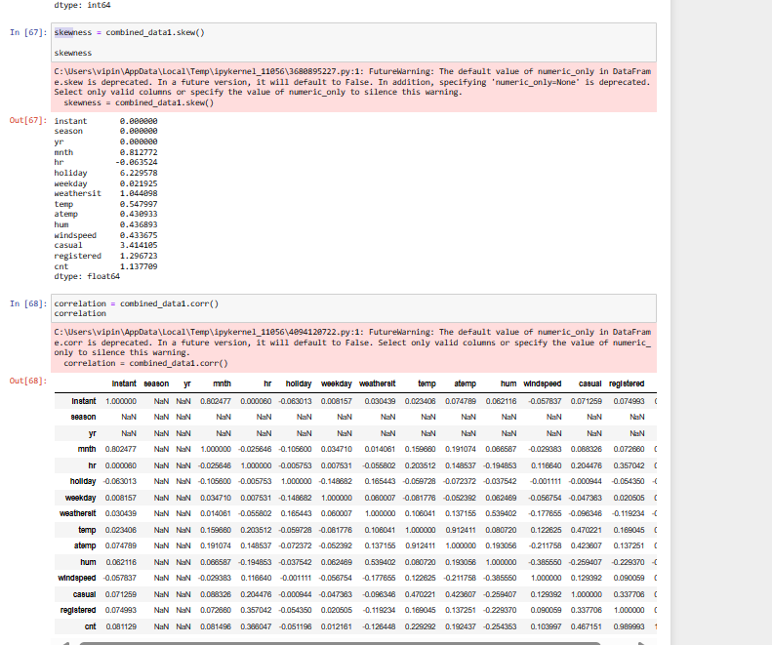
Data Analysis
Skewness and correlation analysis were performed to understand the distribution and relationships between variables in the dataset.

Slide 15
The datasets were successfully cleaned and prepared for further analysis.
Data wrangling techniques helped address ambiguities and inconsistencies in the datasets.
Descriptive statistics provided insights into the dataset's characteristics, such as the distribution of temperature, humidity, and rental counts.
Outliers were identified and removed to ensure the quality of the data.
Skewness and correlation analysis provided additional insights into the dataset's distribution and relationships between variables.
Conclusions

Slide 16
Thanks

